Slide 1
Customer Churn Analysis
By Omer Hoz And Mathias Ankri

Slide 2
Table of Contents
01
02
03
04
Backstory
Churn Analysis
Addressing Key Questions
Conclusion and Recommendations
Notes:
Mathias

Slide 3
01
Backstory

Slide 4

About the Project
Our research suggests that acquiring a new customer may be up to 600% more expensive than retaining an existing one.
The goal of our project is to understand why customers leave a telecommunications company. We have been provided with extensive data about the company's customer base, including demographic information such as age, service usage patterns, and subscription details.
Notes:
Mathias

Slide 5
Understand general customer churn
This analysis serves as a crucial step in understanding the factors driving customer churn, empowering the company to implement targeted strategies for reducing churn rates.
Objectives
Identify the different churning profiles
Through our analysis, we aim to identify distinct churning profiles within the customer base, elucidating unique patterns and characteristics associated with customer attrition.
Develop Retention Strategies
This analysis aims to provide insights to the company on strategies to increase the proportion of customers who remain loyal and do not churn.
Notes:
Omer

Slide 6
02
Churn Analysis

Slide 7

Analysis
Proportion of churned customer in the company
Proportion of churned customer by tenure
Distribution of customers churn by contract type
Probability of a random customer to leave
Notes:
Mathias
Tenure = חוזה
Distribution = התפלגות

Slide 8
03
Addressing key Questions

Slide 9
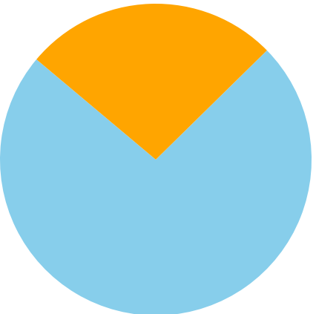
Analysis: Proportion of churned customer in the company
Churn rate among customers
Churned
We observe that more than one-quarter of the total customer base has churned
26.5%
Not Churned
Almost three-quarters of all customers can be characterized as satisfied with the service provided by the company
73.5%
Notes:
Mathias

Slide 10
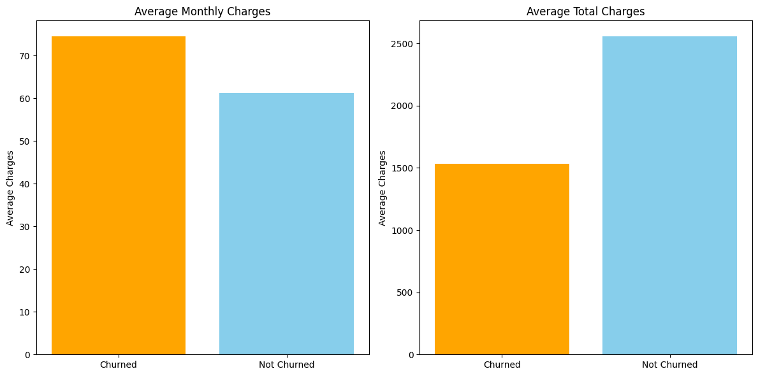
Analysis: Charges
Average monthly and total charges
We can understand from these graphs that customers who churn, tend to be those with higher monthly charges but lower total charges, it can eventually say that these customers tend to leave the company relatively earlier in their tenure
Notes:
Mathias

Slide 11
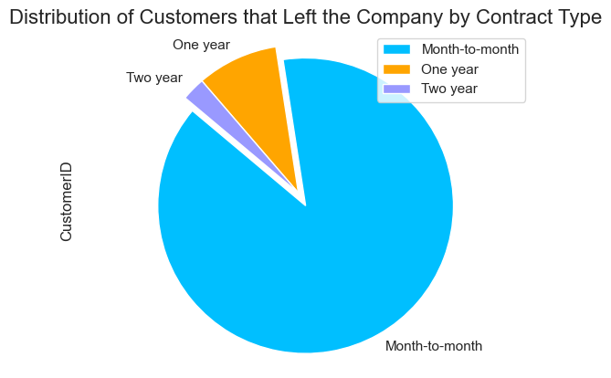
Analysis: Contract type and customer churn
88.6 %
We can notice that almost all the churned customer are customers that take a month-to-month contract.
8.9 %
We can see that not even nine percent of all the churned customers take a one-year contract
2.6 %
We can see that 3 percent of all the churned customers take a two-tear contract
Notes:
Omer

Slide 12
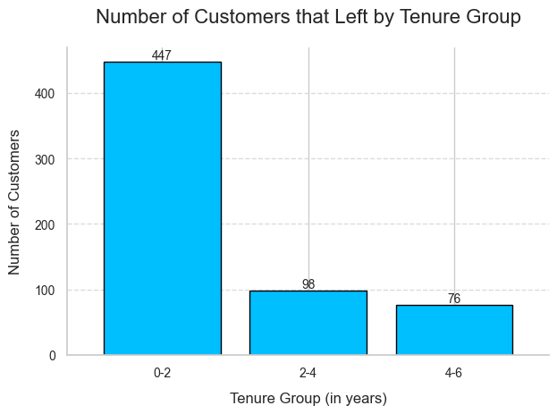
Analysis: Proportion of churned customer by tenure
We can see with this graph that most of the churned customer, or 75 percent according to our analysis, stayed less than two years in the company.
Notes:
Omer

Slide 13
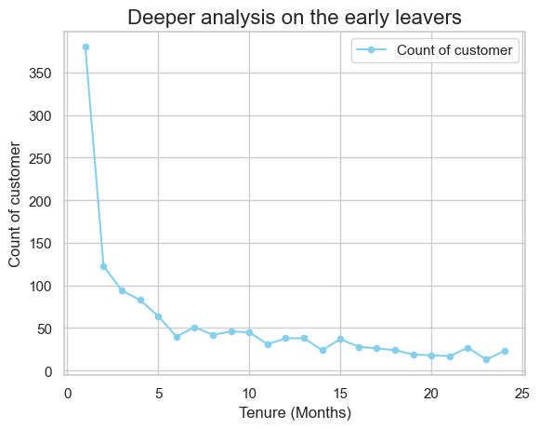
Analysis:
Looking at the graph, we can understand that most of the churned customer have tendency to leave in the five first month of their tenure.
Notes:
Omer

Slide 14
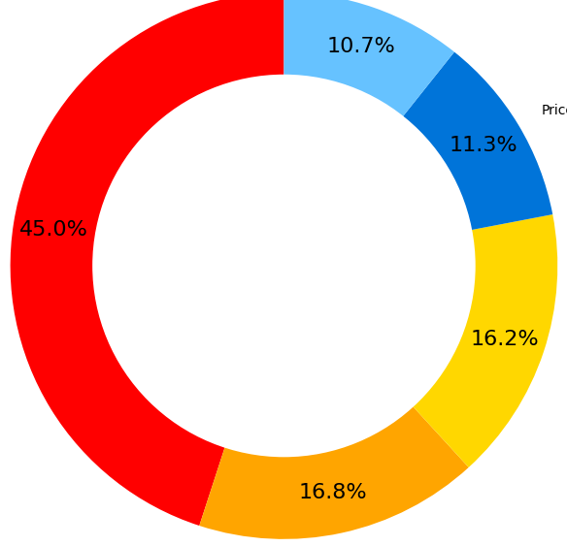
Analysis: Churned category
Competitor
Based on the graph, it appears that a significant portion of churned customers or 45% more precisely may be migrating to a competitor company because they receive a better offer.
Attitude
Dissatisfaction
Price
Other
*based on 1869 churned customers
Notes:
Mathias

Slide 15
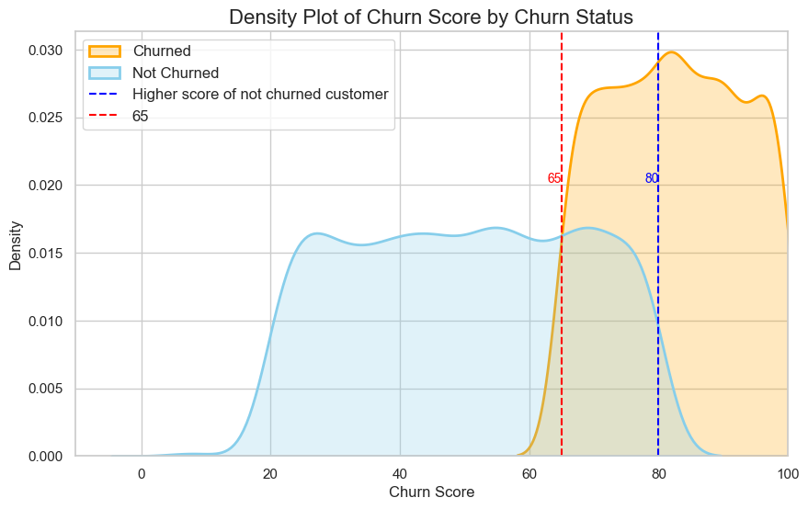
Analysis:
With the aid of the graph, we can discern the remarkable accuracy of the churn score prediction, as we know with the analysis, the churn score predictions is reliable at 95%. It becomes evident that a churn score below 60 typically precedes actual customer churn, while a score under 80 often signifies customer retention.
Notes:
Omer

Slide 16

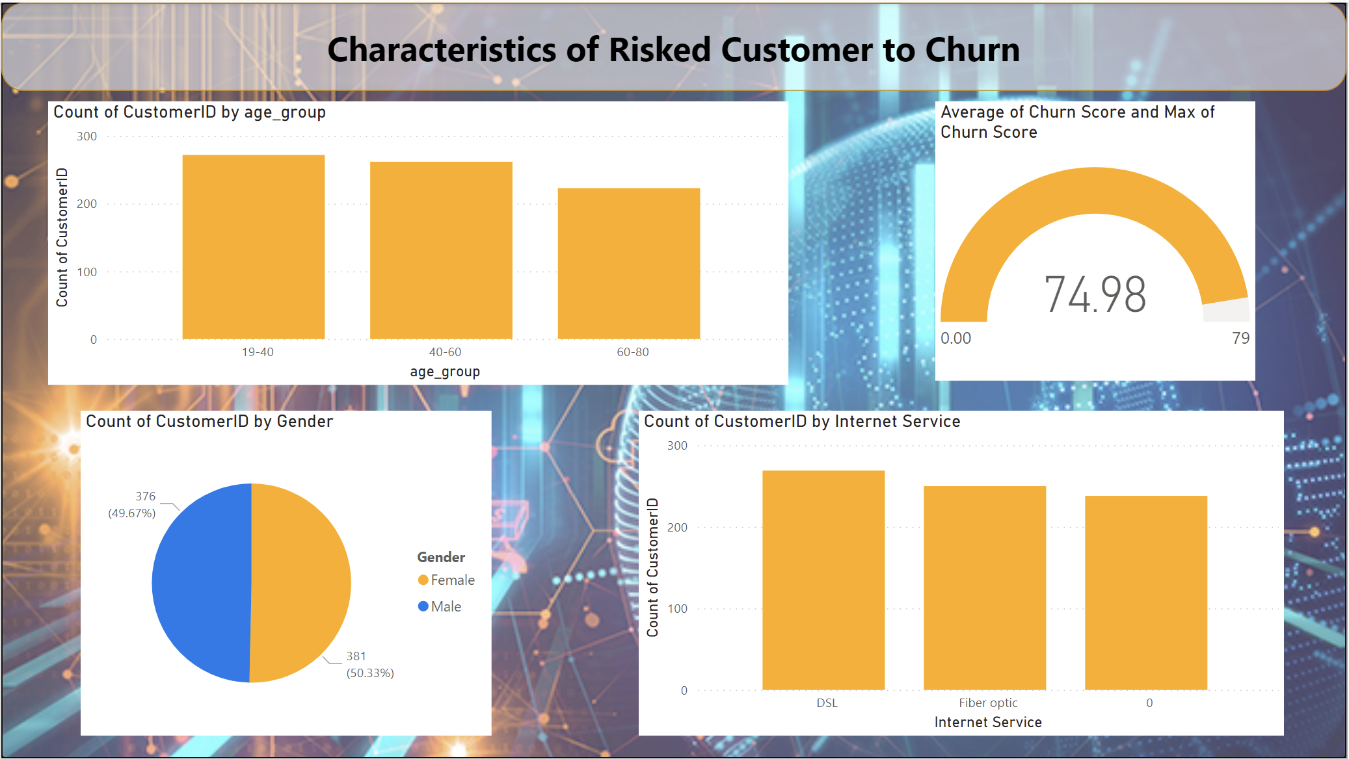

Slide 17
04
Conclusions and recommendations

Slide 18
Conclusions
From all the analysis, we can conclude about the churned customers that :
75% of the customers used to churn in the two first years of their tenure.
45% of the customers churn from the company because they receive better offer from competitor.
33% from the churned customers complain a lot about the attitude of sellers and are not satisfied by the services.
Customer that stays at least five months tend to stay longer in the company.
Notes:
Mathias

Slide 19

Recommendations
From the analysis we did, we can give multiple recommendations according to increase the retention of the customers :
Due to the churn reasons of the left customers ,the company should understand how they are ’’ fighting ‘’ their competitors and emphasize the attitude of the service providers
According to the left customers tenure group, 88.6% of the left customers signed a month-to-month contract. Therefore, we are recommending them to reduce the price of the one-year and the two-year contract.
We recommend to create a new program of a half-year plan as a better alternative to the month-to-month plan.
Notes:
Omer

Slide 20
Thanks!

